Slide 1

Semiconductors
Direct band and Indirect band
Elemental and Non-elemental
p-doped and n-doped
Stoichiometric and non-stoichiometric compounds
Chalcogen semiconductors

Slide 2
Semiconductor - Introduction
Semiconductors (SC) have conductivity in-between that of conductors and insulators.
Their conductivity is approximately 10⁻⁸ ohm⁻¹cm⁻¹ at room temperature.
A solid is said to be a SC, if
Almost filled valence band
Empty conduction band
Very narrow band gap energy, Eg = 0.5 – 2.0 eV
At zero Kelvin (0 K), SC is an insulator. Thermal agitation will lift some amount of electrons from valence band (VB) to conduction band (CB).
Example: Elemental Si (Eg = 1.1 eV) and Elemental Ge (0.7 eV)
Chemical impurities and crystal defects determine the conductivity of SC.
Oxides (ceramic materials) like ZnO, NiO, V₂O₅ are good SC with narrow Eg ~ 1.0 eV due to lattice defects.

Slide 3
Semiconductor - Classification
Semiconductor (SC)
Elemental
Non-elemental/Compound
Intrinsic
Pure Si & Ge
Extrinsic
Doped Si & Ge
n-type: Pentavalent
(P, As, Sb)
p-type: Trivalent
(Ba,Ga,In,Al)
Stoichiometric (1:1)
Group – III & V
CdTe, CdSe
Group – II & VI
GaAs, GaP
Non-stoichiometric
Lattice Defects
n-type – Zn_{(1+x)}O
p- type – Fe_{0.9}O
Chalcogen SC
Se or As₂Se₃
Photoconductors

Slide 4
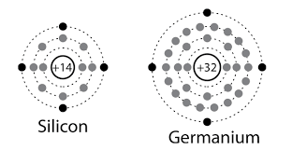
Elemental Semiconductor
Example: Silicon (Si) and Germanium (Ge)
Classified into two types (1) Intrinsic Semiconductor and (2) Extrinsic Semiconductor
(1) Intrinsic Semiconductor
Example: Pure Si and Ge
Semiconducting behavior can be explained by two approaches
Atomic Lattice Model
Band Theory of Solids

Slide 5
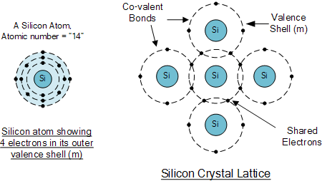
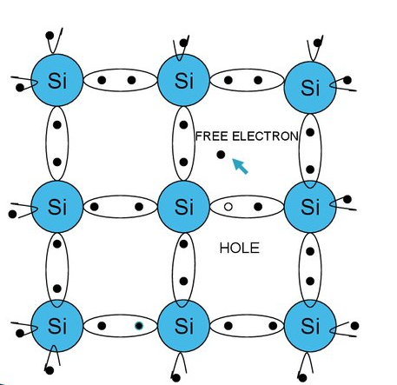
Atomic Lattice Model
Two dimensional lattice model of Si (Diamond cubic lattice), where Si is sp³ hybridized.
Above ‘0’ K, some electrons are thermally released and are free to move through the crystal lattice. These electrons provide a mechanism of electrical conductivity and called as “conduction electrons”.
The vacant positions are called holes.
The number of electrons released is equal to number of holes generated. Hence there is electrical neutrality.

Slide 6
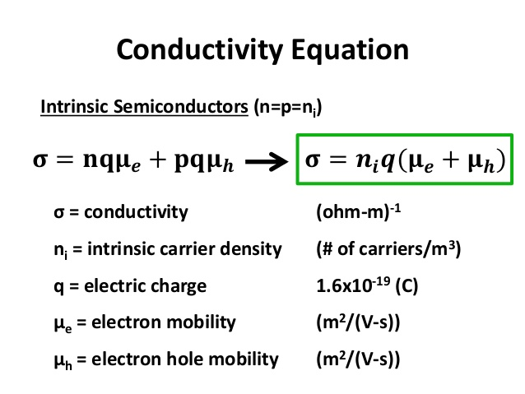
Total conductivity of Si crystal is due to transport of both electrons and holes

Slide 7
(2) Extrinsic Semiconductor
Intrinsic SC can have their conductivities increased by deliberate addition of impurity atoms (known as dopants)
Type of SC | Host Lattice | Impurities
p- type | Si & Ge | Ba, Ga, In, Al (Trivalent)
n-type | Si & Ge | P, As, Sb (Pentavalent)

Slide 8
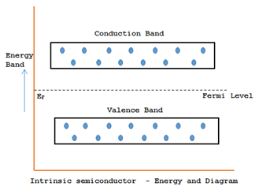
(b) Band Theory of Solids
Above ‘0’ K
Electronic Configuration for Si: 1s²2s²2p⁶3s²3p²
Electronic Configuration for Ge: 1s²2s²2p⁶3s²3p⁶3d¹⁰4s²4p²
By applying the Band theory of solids, according to molecular orbital theory
Completely filled valence band (VB) and empty conduction band (CB)
Above ‘0’ K, thermal agitation leads electrons from VB to CB and generation of holes

Slide 9
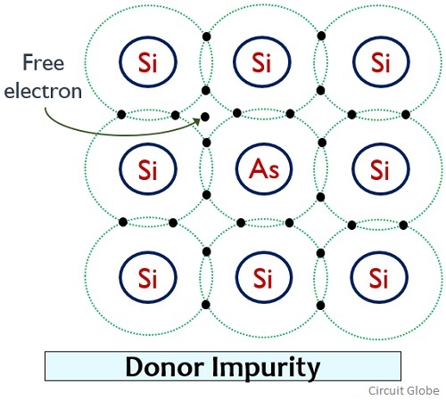
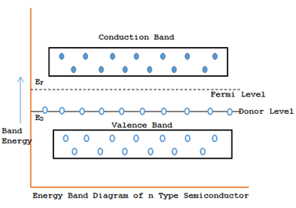
(i) n-type extrinsic semiconductots
Pentavalent donor atoms (P,As,Sb) with excess one electron is doped with Pure Si or Ge

Slide 10
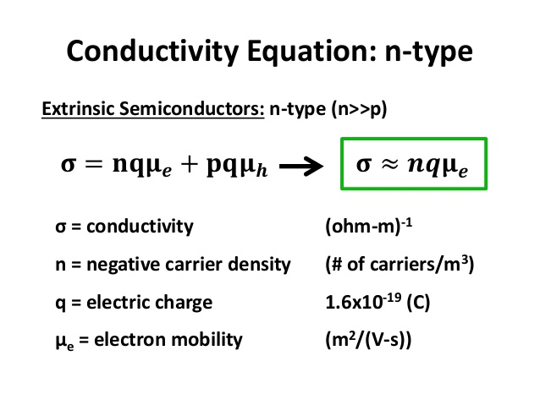

Slide 11
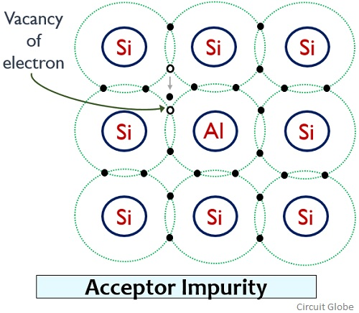
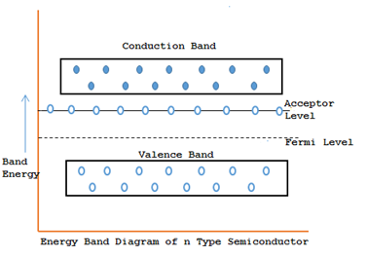
(i) p-type extrinsic semiconductots
p
Trivalent acceptor atoms (Ba,Ga,In,Al) with one electron less is doped with Pure Si or Ge

Slide 12
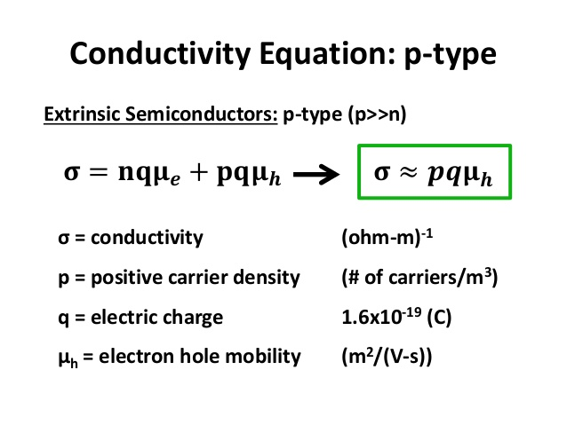

Slide 13
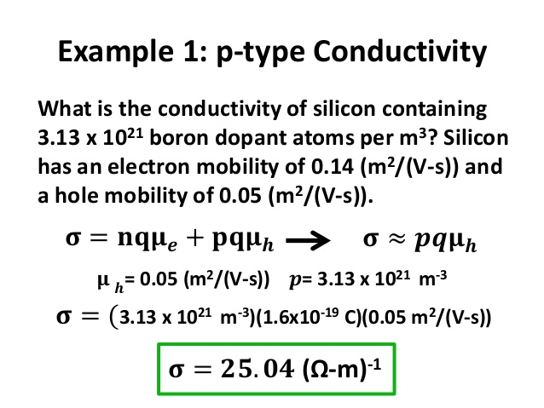

Slide 14
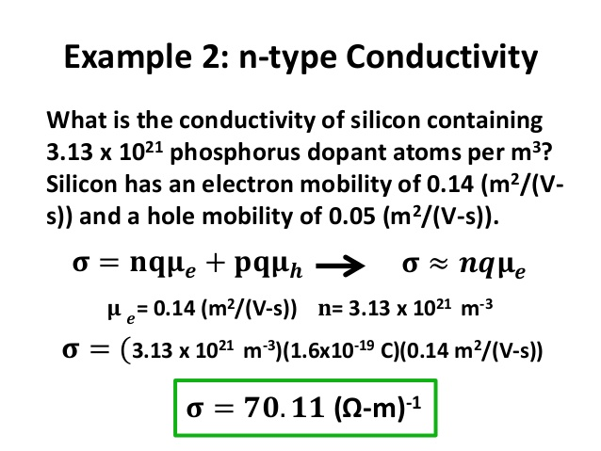

Slide 15
Decrease in band gap down group – IV
When atoms are far apart, their electron waves does not overlap. Whereas, when atoms are brought closer and their electron waves overlap resulting in the energy difference between bonding and antibonding orbitals.
The closer the atoms get to each other, the stronger the interaction and the greater the energy separation between bonding and antibonding orbitals.
Smaller atoms get closer together, so the bonding-anti-bonding energy separation is larger and hence band gap is larger.
The orbitals for two carbon atoms in diamond interact more strongly than those of Si, Ge, Sn and Pb.

Slide 16
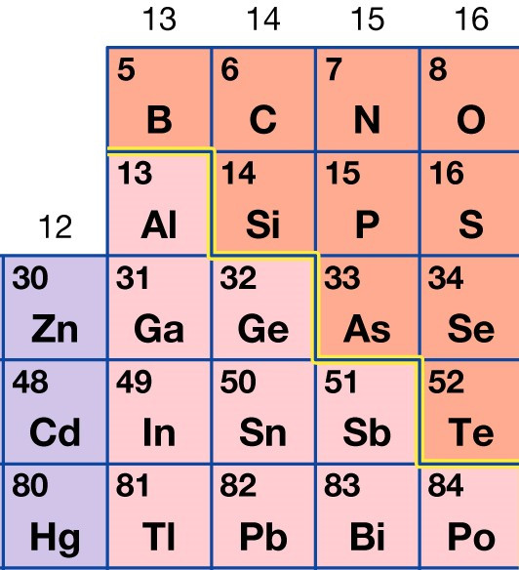
Non-elemental Semiconductor
II
III
IV
V
VI
Non-elemental semiconductors are formed by the compounds formed from the combination of
Group - III and V Elements (Ex: GaAs, GaP, GaN, InAs, InSb)
Group – II and VI Elements (Ex: ZnO, ZnS, ZnSe, CdSe, CdTe)
Called as Compound Semiconductors and Mixed Valence Semiconductors.
These semiconductors have specific optical properties and are used in optoelectronic devices, like LEDs
III-V combinations crystallize either in the diamond lattice like Si or Ge, often called "Zinc blende" or ZnS structure (the term "sphalerite structure" is used, too), or in an hexagonal lattice known as "wurtzite".

Slide 17
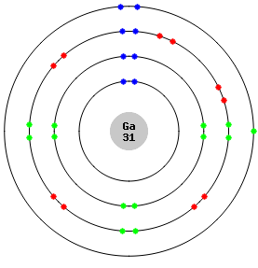
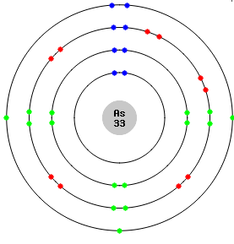
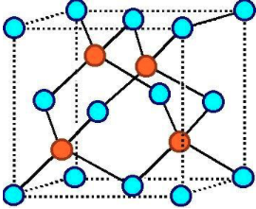
Non-elemental Semiconductor
Stoichiometric compounds
Gallium Arsenide
[Ar] 3d¹⁰ 4s² 4p¹
[Ar] 3d¹⁰ 4s² 4p³
Ga→4s²4p¹
As→4s² 4p³
Ga
As
Zn Blende crystal lattice structure of GaAs
Gallium arsenide has been developed for use in solar cells at about the same time that it's been developed for light-emitting diodes (LEDs), lasers, and other electronic devices that use light.

Slide 18
Gallium has three electrons in the outer shell, while arsenic has five electrons.
GaAs could be formed as an insulator by transferring three electrons from gallium to arsenic; however, this does not occur. Instead, the bonding is more covalent, and gallium arsenide is a covalent semiconductor.
The outer shells of the gallium atoms contribute three electrons, and those of the arsenic atoms contribute five, providing the eight electrons needed for four covalent bonds. The centers of the bonds are not at the midpoint between the ions but are shifted slightly toward the arsenic.
All III–V semiconductors are covalently bonded and typically have the zinc blende structure with four neighbors per atom. Most common semiconductors favor this arrangement.

Slide 19
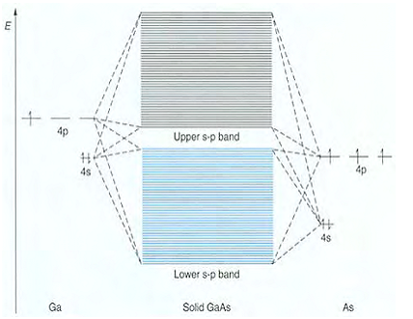
Orbital energy level diagram for gallium arsenide.
The valence orbitals in Ga and As are the 4s and 4p and these form two bands each containing 4N electrons as in silicon.
Because of the different 4s and 4p atomic orbital energies in Ga and As, however, the lower band will have a greater contribution from As and the conduction band will have a higher contribution from Ga.
Thus, GaAs can be considered as having partial ionic character because there is a partial transfer of electrons from Ga to As.
The valence band has more arsenic than gallium character and so all the valence electrons end up in orbitals in which the possibility of being near an As nucleus is greater than that of being near a Ga nucleus.
Band energy gap of GaAs is 1.35 eV

Slide 20
For the semiconducting solids, the band gap decreases down a group,
for example, GaP> GaAs>GaSb; AlAs>GaAs>InAs.
Predicting relative band gaps is based on two factors:
Band gap increases with interaction between atoms. Atomic interaction increases the size of component elements decreases.
Band gap energy increases as the electronegativity difference between the component elements increases.
The band gap for Ge is 0.7 eV, GaAs is 1.35 eV and ZnSe 2.58 eV
Ge, Ga, As, Zn, Se are fourth period elements.
Element | Average size (pm)
Ga | 126
As | 120
Ge | 122
Zn | 126
Se | 116
Electronegativity
1.81
2.18
2.01
1.65
2.55

Slide 21
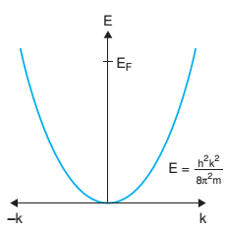
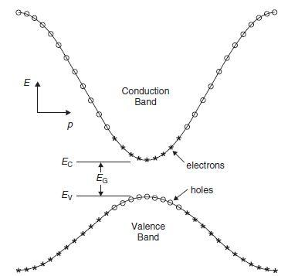
Direct band gap and Indirect band gap Semiconductor
According to Free electron theory, a free electron satisfies the equation:
E-K Diagram

Slide 22
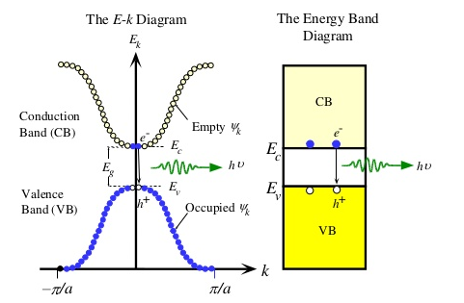
Direct band gap Semiconductor
It has a minimum in CB and maximum in VB for the same k value (k = 0)
An electron in the CB minimum can fall to an empty state in VB maximum, giving off energy difference Eg as a photon of light without a change in k value.
This property is required for a semiconductor to be used as light sources for LED and Laser
Example: GaAs, GaP, InP

Slide 23
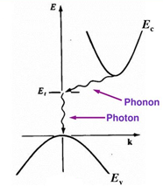
Indirect band gap Semiconductor
It has a minimum in CB and maximum in VB at different k value (k 0)
When an electron in the CB minimum can fall to an empty state in VB maximum,
(i) it falls first to defect state (Et) within the band gap, giving off energy difference as heat (phonon) with a change in k value.
(ii) it falls then to VB maximum, giving off energy difference Et as photon of light, without a change in k value.
This property for a semiconductor cannot be used as light sources for LED and Laser
Example: Si, Ge

Slide 24
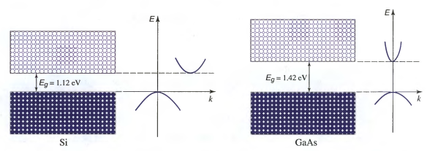
Direct band gap and Indirect band gap Semiconductor

Slide 25
Chalcogen Semiconductor
S, Se, Te - Chalcogens
Compounds of Chalcogens exhibiting semiconducting behavior are called Chalcogen Semiconductors.
Example: Se and As₂Se₃
Exhibit Photocondutivity. Hence called as “Photoconductors” or “Light Sensitive Semiconductors”
The source of energy from an optical beam causes increased charge carriers (electrons) to be excited across the band gap, Eg.
Hence conductivity is increased.
When Se is exposed to a source of light, its conductivity is increased by release of electrons. Hence this property of photosensitivity of Se is adopted in photocopying (Xerox) process.

Slide 26
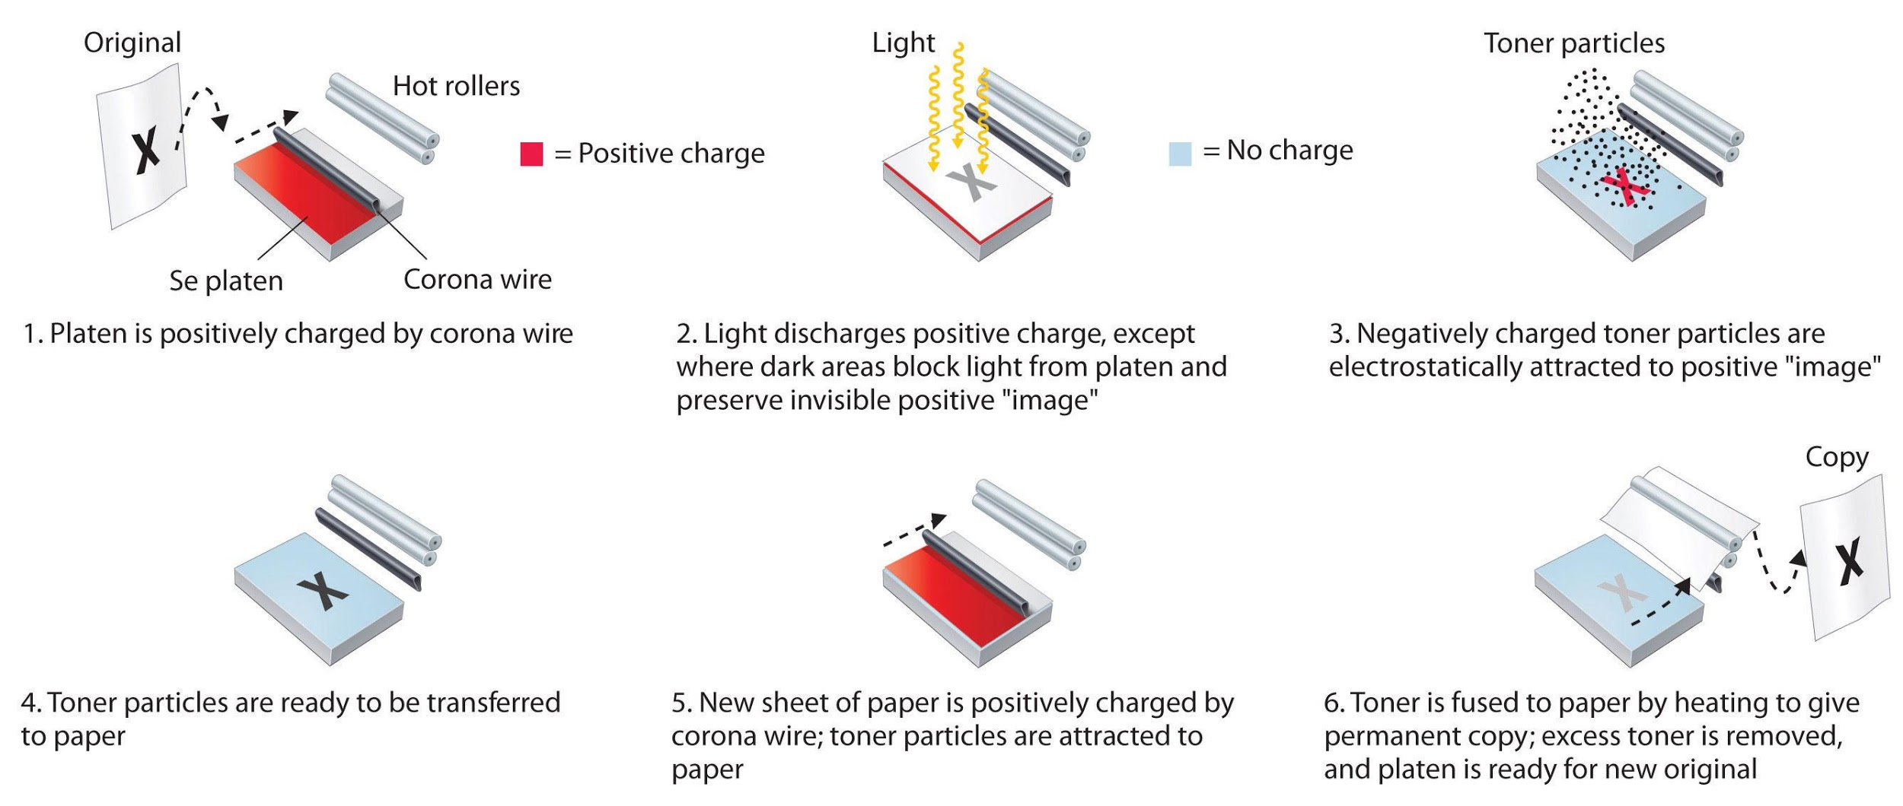
Chemistry of photocopying process
Exposing an electrostatically charged Se film to light causes positive charge on the film to be discharged in all areas that are white in the original. Dark areas in the original block the light and generate an invisible, positively charged image.
To produce an image on paper, negatively charged toner particles are attracted to the positive image, transferred to a negatively charged sheet of blank paper, and fused with the paper at high temperature to give a permanent image.

Slide 27
Non-elemental Semiconductor
Non - Stoichiometric compounds
In a perfect crystal, all atoms would be on their correct lattice positions in the structure. This situation can only exist at the absolute zero of temperature, 0 K. Above 0 K, defects occur in the structure.
Defects can also occur at isolated atomic positions; these are known as point defects, and can be due to the presence of a foreign atom at a particular site or to a vacancy where normally one would expect an atom. Point defects can have significant effects on the chemical and physical properties of the solid.
These defects (or imperfections) in the lattice leads to the semi-conduction and ionic solids are known as Non-stoichiometric Semiconductors”. Ionic solids are able to conduct electricity by a mechanism which is due to the movement of ions through vacant ion sites within the lattice.
For example, transition metal oxides are non-stoichiometric at temperatures above 0 K and hence exhibit semiconducting behavior.

Slide 28
Lattice Defects - Classification
Defects in Ionic Crystals
Stoichiometric Defects
Intrinsic Defects
Non-Stoichiometric Defects
Extrinsic Defects
Metal excess due to anion vacancies
Metal excess due to interstitial cation
Metal deficiency due to cation vacancies
Metal deficiency due to interstitial anion
Schottky Defects
Frenkel Defects

Slide 29
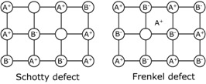
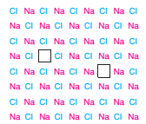
Intrinsic / Stoichiometric Defects
Schottky Defects
A pair of vacant sites, an anion vacancy and a cation vacancy arises. To compensate for the vacancies, there should be two extra atoms at the surface of the crystal for each Schottky defect.
Schottky defect is the principal point defect in the alkali halides. Eg. – NaCl, KBr, CsCl.
There must be equal numbers of anion and cation vacancies in order to preserve local electro-neutrality.
There should be high ionic character.
Size of the cation is comparable to the size of anion.

Slide 30
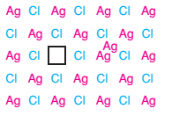
Frenkel Defects
Frenkel defect in AgCl
Involves an atom displaced off its lattice site into an interstitial site that is normally empty.
Size of cation is small and hence crystal structure shows cation lattice defects.
Crystals of low ionic character exhibit Frenkel defects.
Eg – ZnS, AgBr, AgI.
Since anion size is larger, anion lattice defects are less observed.
Calcium fluoride, CaF₂, has predominantly anion Frenkel defects in which F⁻ occupies interstitial sites. Other materials with fluorite and antifluorite structures have similar defects, e.g. Na₂O (Na⁺ interstitial)

Slide 31
Schottky and Frenkel Defects
In a crystal lattice, both Schotty and Frenkel defects can occur simultaneously, if the energy required for both is similar.
Ionic crystals conduct small electricity due to the movement of ions to vacant sites from one end to another end.
This is phenomenon is called as “intrinsic semiconduction”.
Frenkel defects give rise to “cationic intrinsic semiconductor”.
Schottky defects give rise to both “cation and anion intrinsic semiconductor”.

Slide 32
Extrinsic / Non-stoichiometric Defects
In this type of defects, the composition of ions is not equal (A⁺ ~ B⁻)
Eg. FeS Fe_{0.9}S
These defects occur in addition to the Stoichiometric defects.
Types:
Metal excess due to anion vacancies
Metal excess due to interstitial cations
Metal deficiency due to cation vacancies
Metal deficiency due to interstitial anions

Slide 33
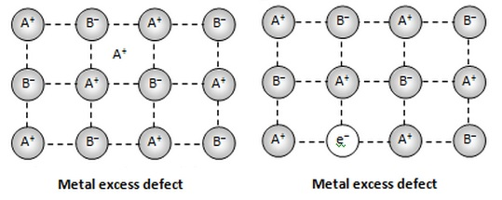
Metal excess due to anion vacancies
Arises due to vacant anion site, which is occupied by electrons.
Occurs along with Schottky defect
Excess electron sites are called F-centres.
More F- centres, higher color intensity.
Eg. NaCl is yellow in color, where the crystal composition is NaCl₍₁₋₆₎
KCl is lilac in color.
F-centres (from the German word Farbenzenter for colour centre)

Slide 34
Metal excess due to interstitial cation
Arises due to presence of interstitial cations.
Occurs along with Frenkel defects.
Eg. Zn_{(1+δ)}O and Cd_{(1+δ)}O

Slide 35
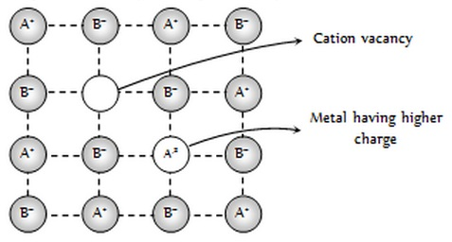
Metal deficiency due to cation vacancies
Arises due to absence of cations in lattice sites.
Presence of metal having higher charge.
Presence of excess electron
Eg. Fe_{(1-δ)}O and Fe_{(1-δ)}S

Slide 36
Metal deficiency due to interstitial anion
Arises due to presence of additional anions at interstitial sites.
Crystals have complete cation and anion lattices with no vacant sites to compensate for interstitial anions.
Since anions are generally larger, it cannot occupy interstitial sites. Hence the structure of only theoretical possibility and there are no examples.
Calcium fluoride, CaF₂, has predominantly anion Frenkel defects in which F⁻ occupies interstitial sites. Other materials with fluorite and antifluorite structures have similar defects, e.g. Na₂O (Na⁺ interstitial)

Slide 37
Consequences of Non-Stoichiometric defects
A crystal with “metal excess” carry electrons through normal electron conduction mechanism, hence they are called as n-type semiconductors.
A crystal with “metal deficiency” carry electrons through positive hole conduction mechanism, hence it is called as p-type semiconductor.

Slide 38
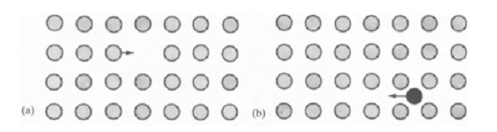
Conduction Mechanism in Non-Stoichiometric semiconductors
The most important aspects of extrinsic defects is that they make it possible for ionic conduction through the lattice.
Two mechanisms are possible:
Vacancy mechanism: An ion hops or jumps from its normal position on the lattice to a neighboring equivalent but vacant site. This is depicted as movement of vacancy instead of movement of ions.
(b) Interstitial Mechanism: An interstitial ion jumps or hops to an adjacent equivalent site.
(a) Vacancy mechanism
(b) Interstitial mechanism
Movement of ions in a lattice are known as “Hopping Model”

Slide 39
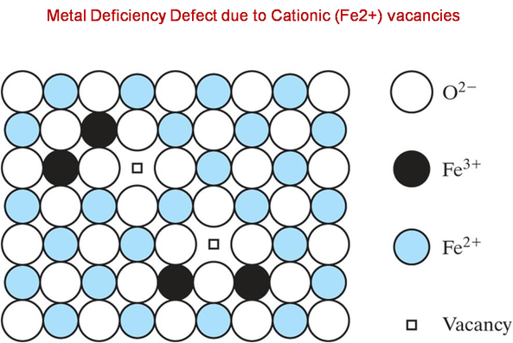
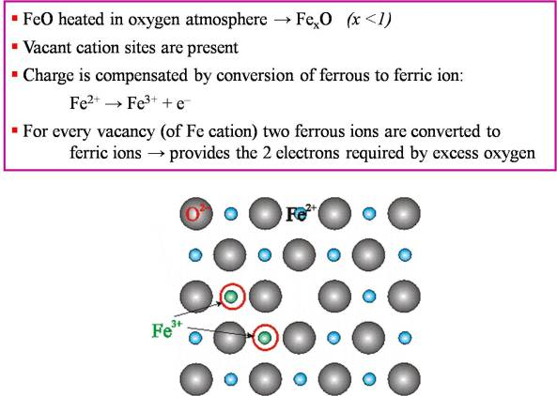
Non-Stoichiometric p-type semiconductor
A “cation deficient” lattice gives rise to p-type semiconductivity in ionic crystals
Semiconductivity of FeO
Since Fe³⁺ ion is one e⁻ deficient in comparison to Fe²⁺ lattice, Fe³⁺ ion can be considered as a hole.
The mechanism of conduction in such materials are due to hopping of holes between equivalent Fe³⁺ sites of FeO lattice under applied field

Slide 40
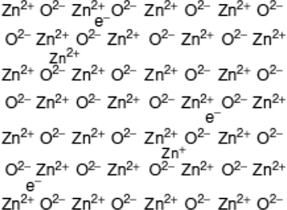
Non-Stoichiometric n-type semiconductor
A “cation excess” lattice by having either “oxygen vacant” or “interstitial cation” gives rise to n-type semiconductivity in ionic crystals and electrons are the charge carriers.
Semiconductivity of ZnO
Upon heating, Zn²⁺ ions occupy interstitial sites of ZnO lattice.
2e⁻ occupies interstitial sites to balance the excess positive charge of the lattice.
The excess e⁻ in the interstitial sites are available for conduction under applied field.

Slide 41
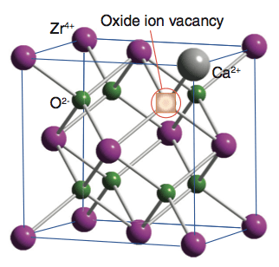
Fast Ion Conductors
Crystals with extrinsic defects exhibits ionic conduction and can be used as “fast ion conductors”
Stabilized Zirconias
The introduction of a Ca²⁺ ion into the ZrO₂ lattice produces a vacancy on the O²⁻ sub-lattice.
This substitution helps to stabilise the cubic fluorite structure of ZrO₂

Slide 42
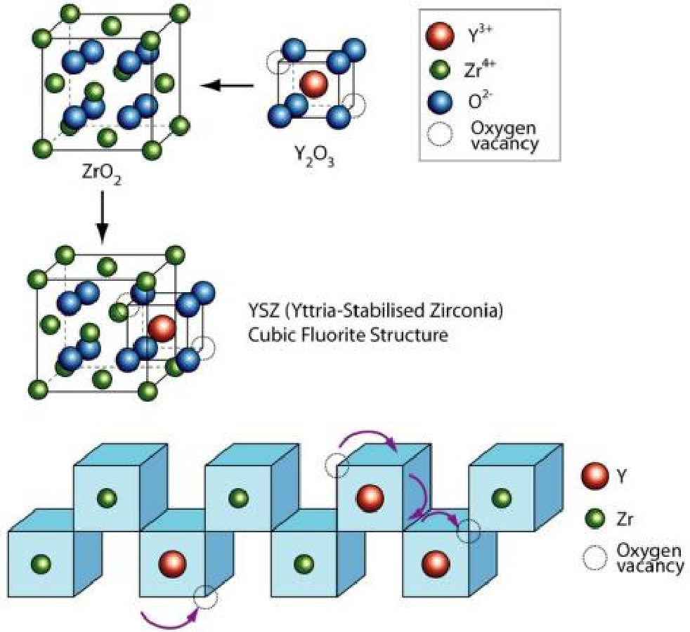
Oxygen Ion conductors – Yttria-stabilized Zirconia (YSZ)
Compensating anion oxygen vacancies must appear in the system ZrO₂-Y₂O₃, in order to maintain the charge balance of the composition because zirconium valence is higher than that of yttrium.

Slide 43
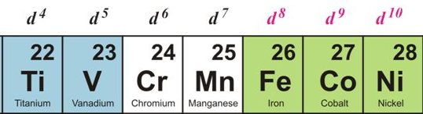
Electrical conductivity of Transition Metal Oxides
Transition metal oxides (MO) – TiO, VO, MnO, FeO, CoO and NiO
These MOs crystallize into ionic cubic lattice structures like NaCl.
TiO and VO are metallic conductors and the rest of MOs are semiconductors.
The difference in their conductivity is based on the
i) nature of ‘d’ orbitals in metals
ii) band structure of solids
iii) band occupancy

Slide 44
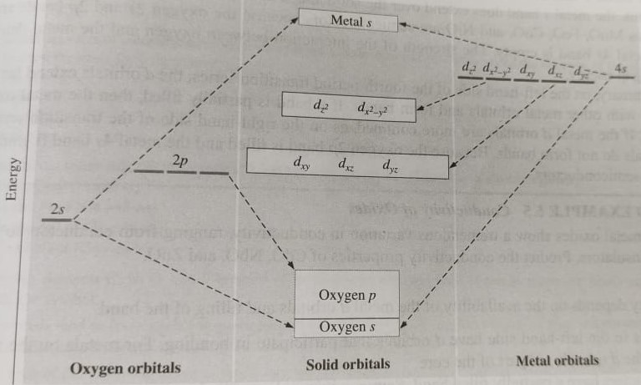
Band Structure of MOs
M and O orbitals mix to form Bonding and Antibonding Molecular Orbitals.
Since “O” is more electronegative, the bonding combination is pure “O” s-band states, while the antibonding is essentially the metal s-band. The “O” p-orbitals also do not mix with the metal orbitals.
In solids, two ‘d’ orbitals (dz²,dx²-y²) are directed at oxygen and other 3 d-orbitals are pointed between oxygen.
In TiO, 6 valence e⁻s for O & 4 valence e⁻s for Ti.
10 e⁻s fill O s-band (2 e⁻s) & p-bands (6 e⁻s) first.
Remaining 2 e⁻s only partly fill lower energy d-band of M.
Hence TiO is conductor.
Similarly, VO has 11 e⁻s and d-bands are partly filled. Hence both TiO and VO are conductors.

Slide 45
Band Structure of MOs
Other oxides MnO, FeO, CoO and NiO are semiconductors. Moving from left to right across transition series, d-orbitals are increasingly pulled into the core and d-orbitals are less available for bonding, i.e d-orbitals become more confined to the metal core.
The metal s-orbitals extend farthest and so overlap with neighbouring atoms. Thus, the metal s-band does extend over the solid and is able to accept e⁻s for conduction. Here oxygen 2s and 2p bands are filled, but the metal 4s band is empty.

Slide 46
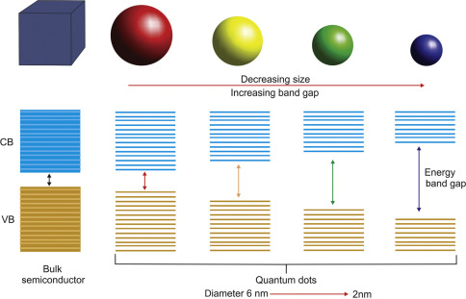
Quantum Dots
QDs are the class of materials in which quantum confinement effects can be evidenced. They are very small semiconductor crystals on the order of nanometer size, containing merely a hundred to a thousand atoms.
QDs exhibit electronic properties intermediate to those of bulk semiconductors and isolated molecules.
QDs can be made from single-element materials, such as silicon or germanium, or from compound semiconductors, such as CdSe, PbSe, CdTe, and PbS

Slide 47
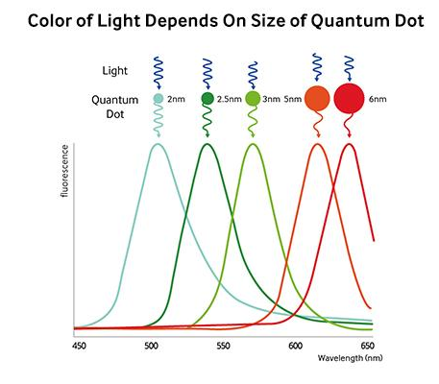
Quantum dots are photo-active; they absorb, and then emit light. And when they do, even if the dots are made of the same material, the light each quantum dot emits is a specific color (or wavelength) depending on the size of its core. For example, a quantum dot with a core of 2 nm will emit a blue light while one with a 6~7 nm core will emit red.

